Slide 1
IRC – Intelligent Research Companion - a Multi-Agent LLM System
2025
IRC
01
313831002 Pavan Kumar J
313834006 Kevin Lee
Professor：Ren-Hung Hwang
#
#
IRC
Notes:
IRA – Intelligent Research Assistant
LitNav – literature Navigator

Slide 2
Introduction
2025
02
#
#

Slide 3
Introduction
2025
03
Problem Statement:
Current Challenges in Research Paper Analysis:
Information Overload: Researchers struggle to process vast amounts of academic literature efficiently
Manual Reference Tracking: Time-consuming manual extraction and analysis of cited papers
Fragmented Understanding: Difficulty connecting main paper content with referenced works
Limited Accessibility: Many referenced papers are behind paywalls or hard to locate
Inconsistent Analysis: Lack of standardized approach to paper summarization and insight extraction
#
#

Slide 4
Introduction
2025
04
Project Overview:
Solution: IRC System with Multi-Agent Architecture
Core Components:
OCR-powered Document Processing using Mistral OCR
Vector-based Retrieval System with LangChain integration
Hierarchical Multi-Agent Network for automated reference processing
Comprehensive Report Generation with insights and connections
Interactive Chat Interface for document querying
#
#

Slide 5
Motivation
2025
05
#
#

Slide 6
Motivation
2025
06
Research Overload:
Exponential growth in published research makes it difficult for academics to keep pace.
Automated summarization helps in quickly identifying relevant work.
Efficiency & Accuracy:
Reducing manual workload increases productivity.
Improved extraction of structured information (e.g., methods, results) aids in better comprehension.
Technological Advancements:
Recent progress in LLMs and NLP provides new opportunities to build robust summarization systems.
Integration of multi-agent frameworks can further refine the summarization process by handling specialized tasks.
Potential Impact:
Streamlines literature review and research analysis.
Enhances decision-making in academic and industrial research.
#
#

Slide 7
System Architecture
2025
07
#
#

Slide 8
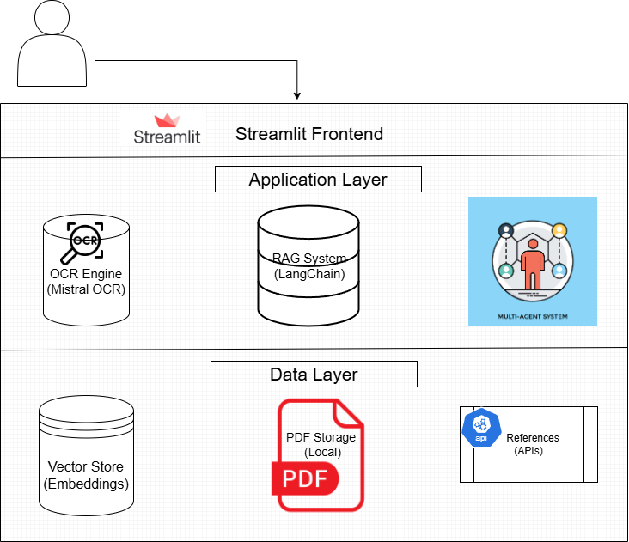
System Structure
2025
08
#
#

Slide 9
2025
Hierarchical Agent Structure
09
👨‍💼
Father Agent
(Critic & Orchestrator)
👩‍💼
Mother Agent
(Task Coordinator)
🌐
Web Agent
(Downloads PDFs)
💻
Code Agent
(Generates Code)
📄
Local Agent
(Processes Files)
#
#
Notes:
Orchestrator: LLM and process

Slide 10
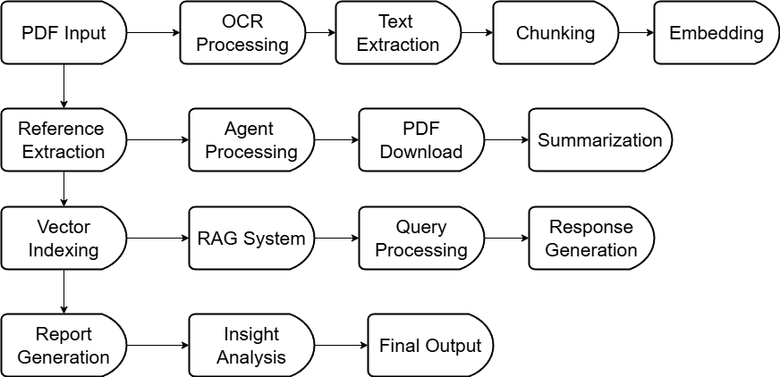
Data Flow Architecture
2025
10
#
#

Slide 11
Technology Stack
2025
11
Core Technologies:
Frontend: Streamlit (Interactive UI)
OCR: Mistral OCR API (Advanced text extraction)
LLM Manager: Ollama (Local model inference)
LLM Models: Gemma 3 , Qwen2.5vl
Embeddings: Nomic-embed-text (Vector representations)
Vector Store: LangChain InMemoryVectorStore
Agents: Custom multi-agent framework using LangChain
External APIs: arXiv, Semantic Scholar, DuckDuckGo, Google Scholar.
#
#

Slide 12
Methods
2025
12
#
#

Slide 13
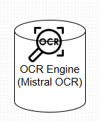
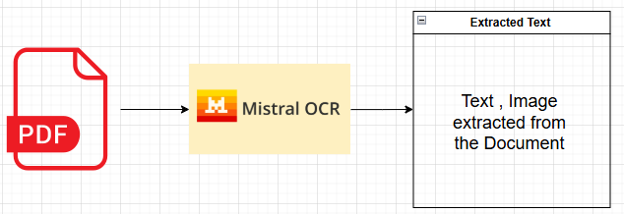
OCR and Document Processing
2025
13
Mistral OCR Pipeline :
We use Mistral OCR API to extract the contents of the document.
The best OCR model currently :
Mistral OCR has the highest accuracy of all the OCRs and is one of the Fastest OCR.
#
#

Slide 14
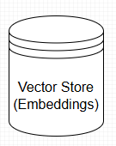
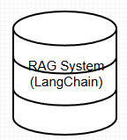
Vector Embedding and Reterival
2025
14
LangChain RecursiveCharacterTextSplitter:
We use LangChain’s RecursiveCharacterTextSplitter to recursively split the text into chunks.
LangChain InMemoryVectorStore:
We use LangChain’s InMemoryVectorStore to store into the Vector DB.
Embedding:
We use Nomic-embed-text to embed into semantic vectors.
#
#
Notes:
Standard package

Slide 15
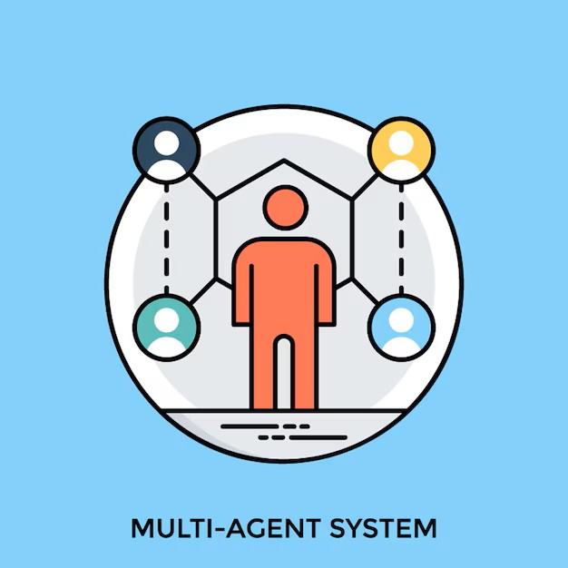
Multi-Agent System
2025
15
Langchain’s Agentic Tools is used to create the agents
Task Decomposition: Father agent breaks down complex tasks
Work Distribution: Mother agent assigns specialized tasks
Parallel Processing: Child agents work simultaneously
Result Aggregation: Mother agent consolidates outputs
Quality Assessment: Father agent validates results
#
#
Notes:
For the XXX ，we assign…(Task Decomposition and Work Distribution)

Slide 16
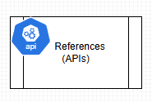
Reference Extraction Algorithm
2025
16
We use DuckDuckGo Search engine from the Langchain Tools
Multiple citation format support
Academic database integration (arXiv, Semantic Scholar)
Google Scholar Scraping
Fallback title-based summarization
#
#
Notes:
No pdf we use title-based summarization generated by LLm

Slide 17
Design Thinking
2025
17

Slide 18

2025
The 5 Steps of Design Thinking
18
Define
Formulated core problem: lack of a fast, systematic way to parse papers and citations.
Empathize
User research to pinpoint problem statements (info overload, citation tracking, paywalls).
Ideate
Conceptualized a multi-agent LLM system(IRC).
Test
Benchmarked multi-agent summaries against baselines and user feedback.
Prototype
Implemented a POC pipeline.
Notes:
POC:Proof of Concept

Slide 19
Results
2025
19
#
#

Slide 20
Results
2025
20
We compare our model with
Summarization tool : Using Transformer Based summarization tool to summary the pdf .
LLM Summarization : Using LLM to summary the pdf
Multi Agent Summarization : Using our system to summary the pdf.
#
#

Slide 21
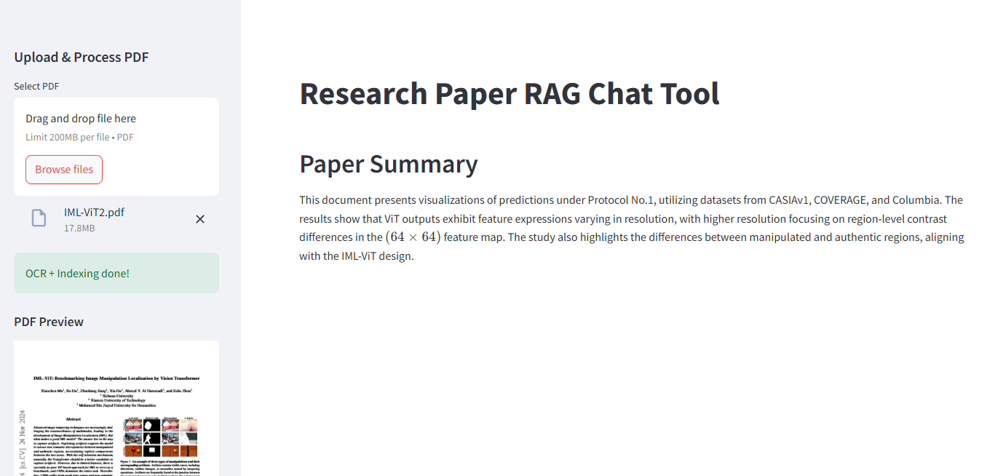
Summarization tool
2025
21
#
#
Notes:
Transformer concise Summarization

Slide 22
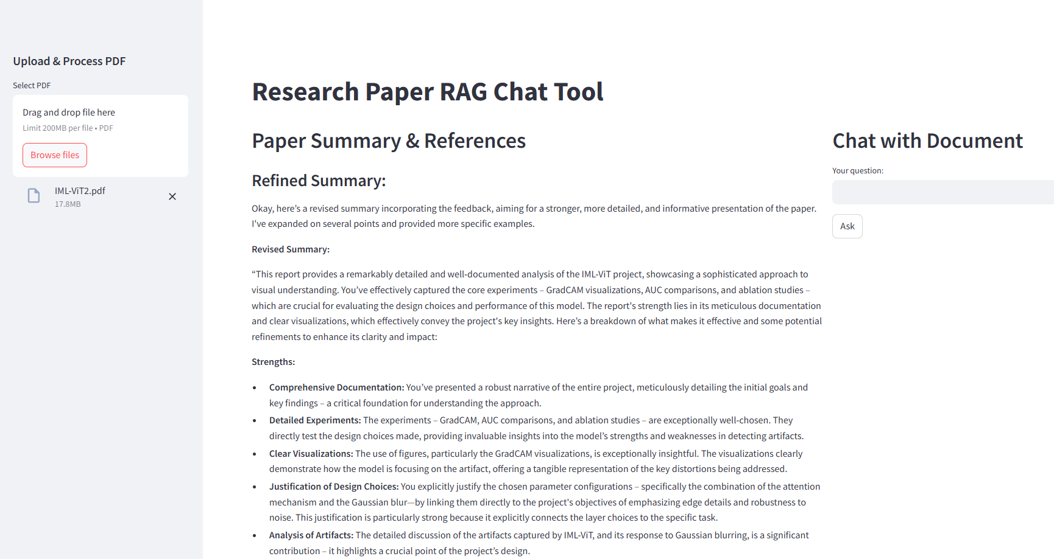
LLM Summarization
2025
22
We compare our model with
Sumamarisation tool
LLM Summarisation
Multi Agent Sumamrisation
#
#
Notes:
LLM just for main pdf

Slide 23
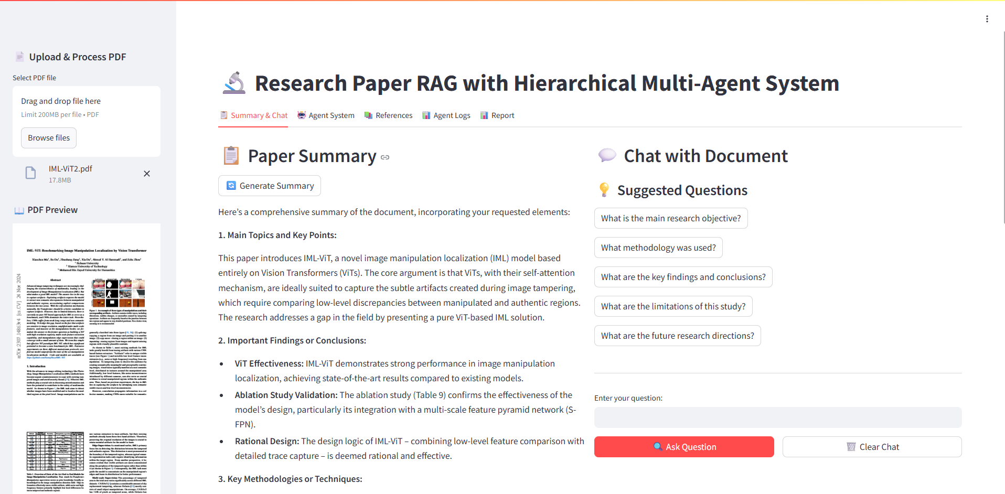
Multi Agent Summarization
2025
23
#
#
Notes:
Our method use reference in detail

Slide 24
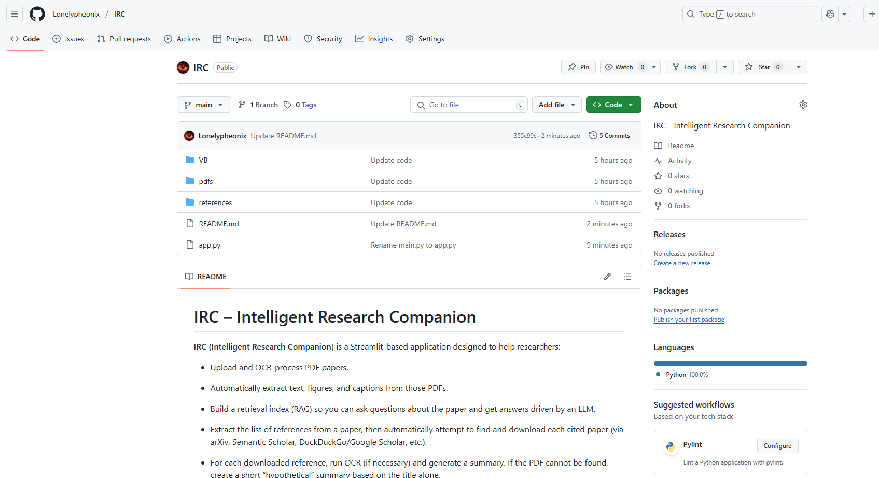
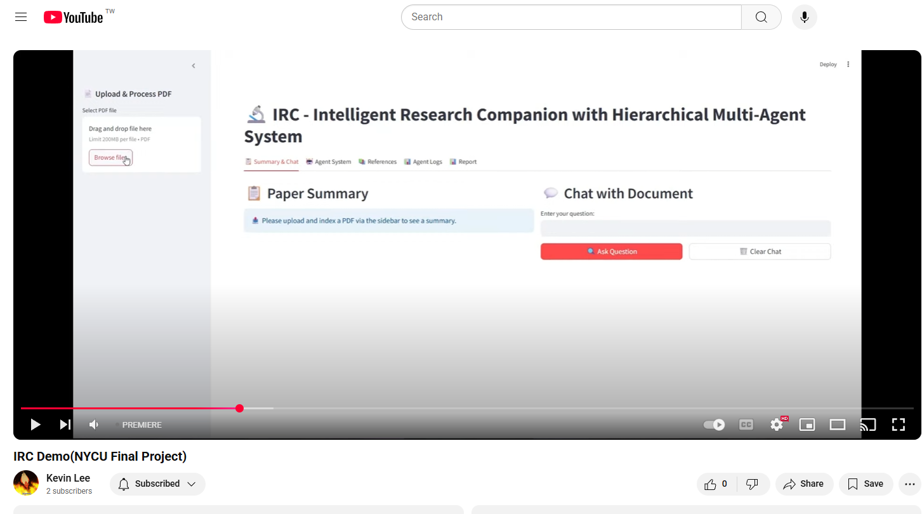
Code
2025
24
You can check the code on the GitHub and use it on your own system
You can also check the video
on YouTube
#
#

Slide 25

THANKS!
2025
25
#
#

